Slide 1
Diabetes Prediction Using Machine Learning
Healthcare Analysis Project
Early diagnosis of diabetes in Pima Indian women for timely intervention and personalized care.
Team Leader–
Ankita Vashisht - 0854392
Team Members –
Swati kumari – 0850708
Karan – 0850990

Slide 2

Executive Summary
Overview: Diabetes is a significant global health challenge with severe complications.
Objective: Develop a data-driven machine learning model for effective prediction and intervention.
Dataset: Pima Indian Diabetes Dataset (768 instances, 9 features).
Tools Used: Python (Scikit-learn, Matplotlib, Seaborn).
Outcome: Random Forest model identified as the most accurate (>85%).

Slide 3

Problem Statement
Challenges:
Undiagnosed gestational diabetes causing complications.
Disparities in healthcare access delay early diagnosis.
Existing tools lack accuracy for underserved populations.
Goal:
Provide an accurate, proactive tool for early diabetes risk prediction.

Slide 4

Dataset and Process Overview
Dataset Key Features:
Pregnancies, Glucose, Blood Pressure, Skin Thickness, Insulin, BMI, Age.
Target Variable: Outcome (Diabetic = 1, Non-Diabetic = 0).
Distribution: 65.1% non-diabetic, 34.9% diabetic.
Process:
Data Preparation: Addressed missing values, standardized features.
Exploratory Data Analysis: Found correlations, resolved data quality issues.
Modeling: Tested Random Forest, Logistic Regression, Decision Trees, KNN, SVM.
Evaluation: Used cross-validation and feature scaling for fair comparison.

Slide 5
Stakeholders and Benefits
Stakeholders:
Patients: Early detection and targeted interventions.
Healthcare Providers: Enhanced decision-making and efficiency.
Researchers: Insights for diabetes prevention and control.
Policy-Makers: Data-driven healthcare strategies.
Focus Groups:
Pima Indian women (highest diabetes prevalence globally).
Pregnant women (1 in 6 pregnancies affected by diabetes).
Underserved populations needing affordable diagnostic tools.

Slide 6
Solution Implementation
Machine Learning Models:
Logistic Regression, Random Forest, Decision Tree, SVM, KNN.
Techniques:
Feature Scaling: Ensures fair comparison.
Cross-Validation: Evaluates robustness.
Outcome:
Random Forest achieved >85% accuracy.
Reduced false negatives for better healthcare outcomes.

Slide 7
Results and Analysis
• Key Insights:
- Features like Glucose and BMI are critical for prediction.
- Early detection can reduce complications by 30%-50%.
- Model effectively handles imbalances in the dataset.
• Outcome:
- Random Forest outperformed other models in accuracy and recall.
- Provides actionable insights for healthcare professionals.

Slide 8
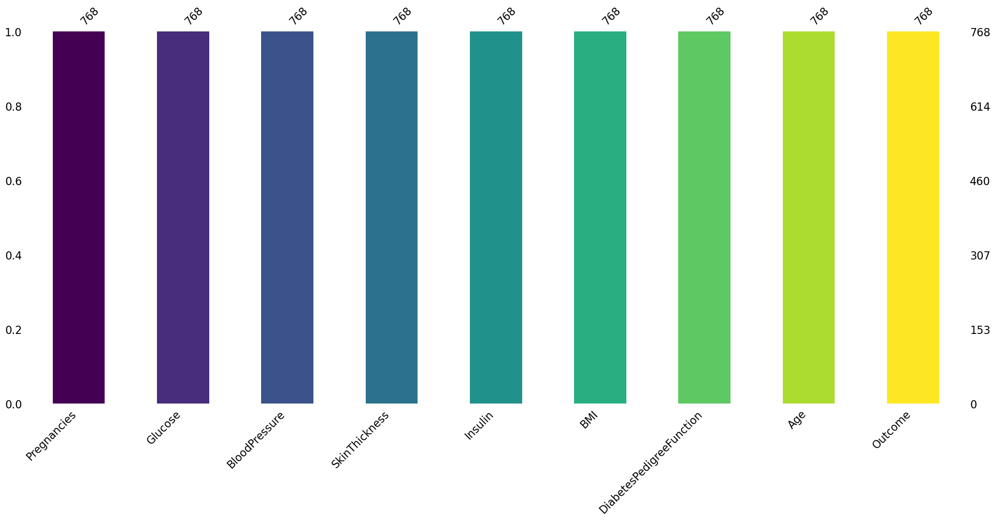
This bar chart shows the count of non-missing values for each feature in a dataset, with all variables having 768 observations. It suggests no missing data in any column.

Slide 9
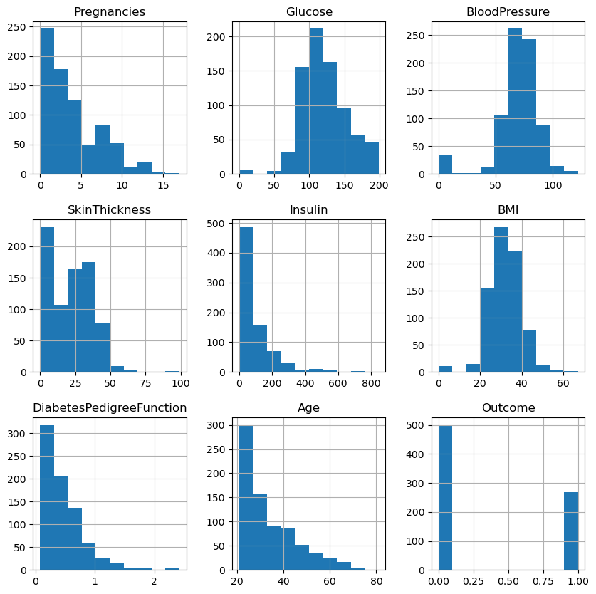
This grid of histograms provides an insightful overview of the dataset's feature distributions. Most features like Glucose and BMI exhibit clear patterns, while others like Insulin and Age reveal unique skews, offering valuable clues for further analysis.

Slide 10
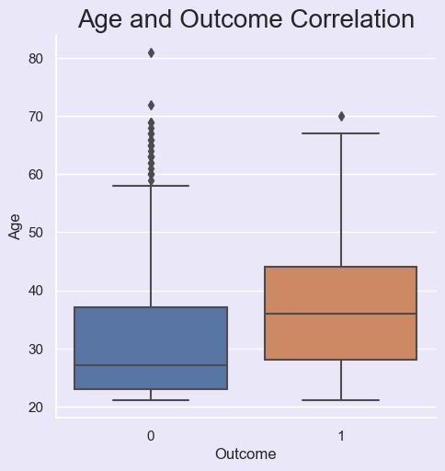
This boxplot illustrates the relationship between age and outcome. Individuals with Outcome 1 tend to be older on average, showing a higher median age and wider age variability compared to those with Outcome 0.

Slide 11
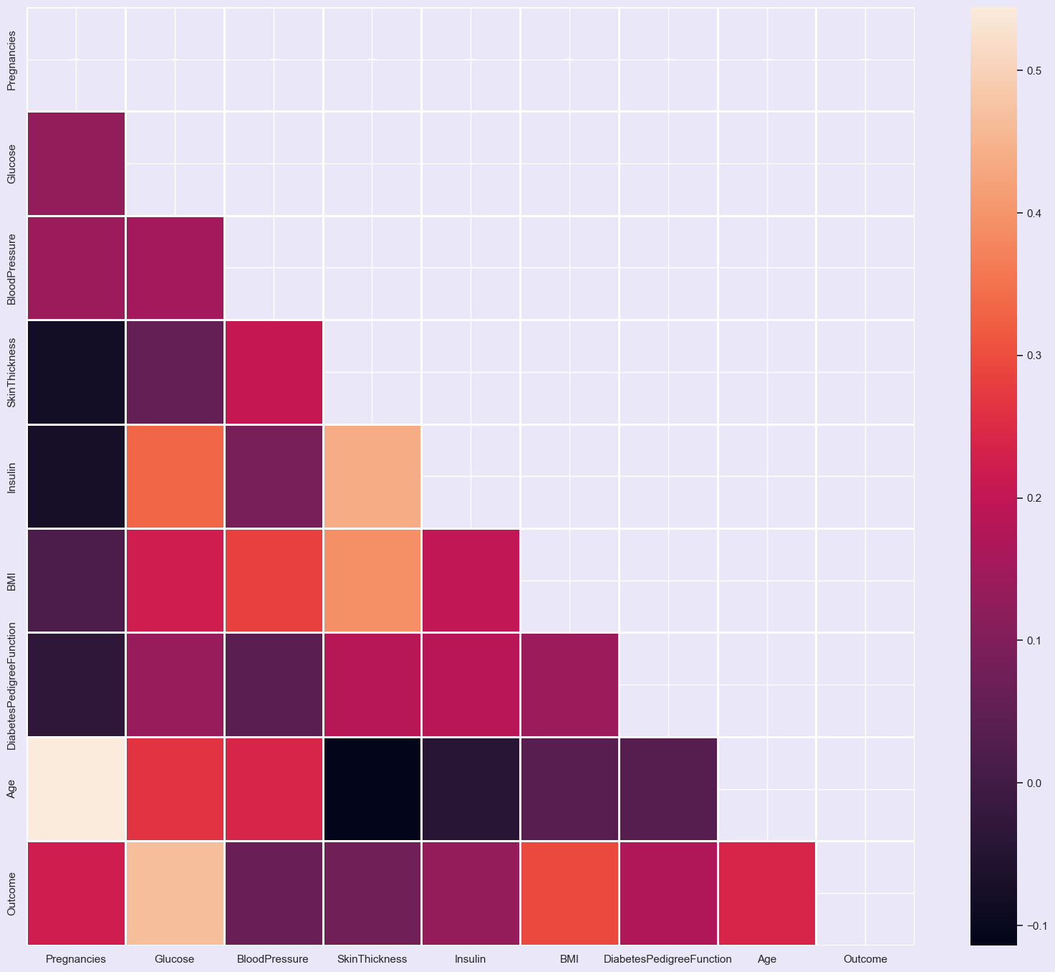
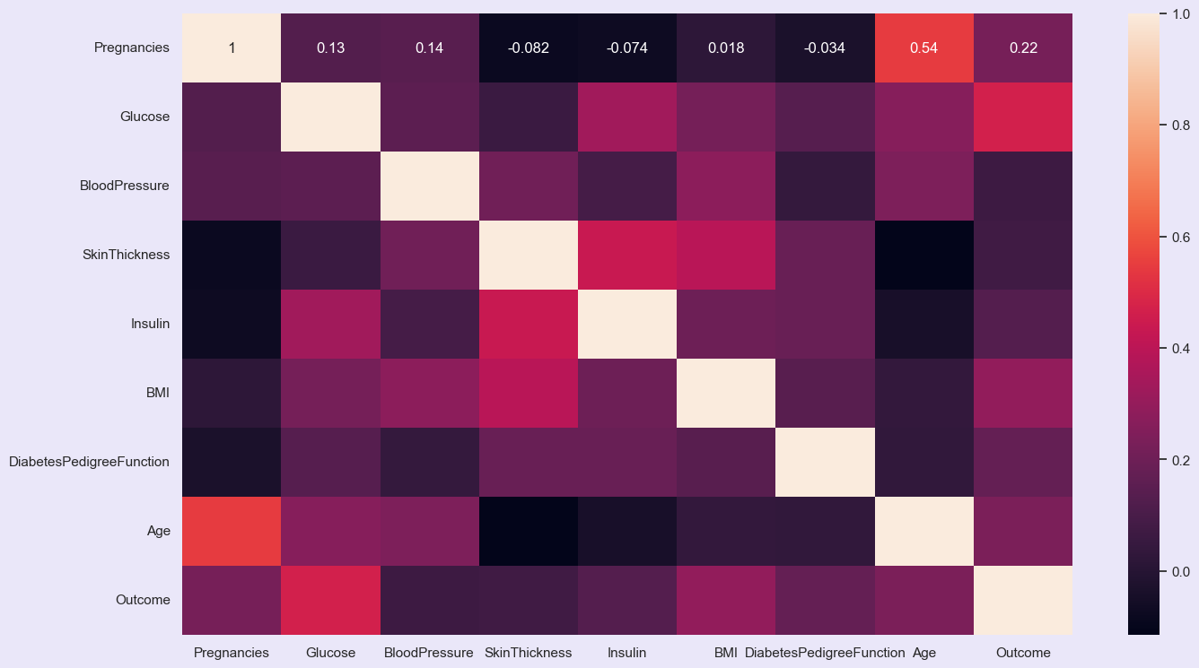
The first heatmap shows pairwise correlations among variables, visually highlighting their relationships through color intensity. The second heatmap adds numeric correlation values for clarity, revealing strong positive correlations like Glucose with Outcome and Age with Pregnancies.

Slide 12
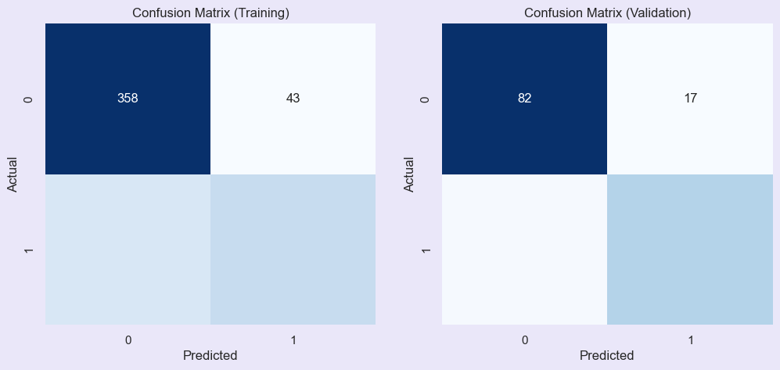
The confusion matrices illustrate the model's performance on training and validation datasets. The training matrix shows strong performance with minimal misclassifications, while the validation matrix indicates slightly reduced accuracy, suggesting potential overfitting or variance in data.

Slide 13
Recommendations and Limitations
Recommendations:
Deploy Random Forest for diabetes prediction.
Use feature importance for patient education.
Expand the approach to other chronic conditions.
Limitations:
Dataset quality affects generalizability.
Requires broader datasets for improved results.
Future Scope:
Explore advanced machine learning techniques and real-time monitoring systems.

Slide 14
Purpose of Presentation
Highlight how machine learning transforms healthcare.
Showcase the role of predictive analytics in saving lives.
Promote proactive, data-driven healthcare management.

Slide 15
DASHBOARD
Objective
To build an interactive dashboard for visualizing diabetes-related data and predicting diabetes outcomes based on user inputs.
Leverages Machine Learning (Random Forest Classifier) and data visualizations to enhance healthcare decision-making.
Core Functions
Exploratory Data Analysis (EDA):
Understand relationships between key health metrics like Age, BMI, Glucose, Insulin, etc.
Identify patterns or clusters in the data that may indicate diabetes risk.
Diabetes Prediction:
Allow healthcare providers to input patient data and receive predictions on diabetes likelihood along with probabilities.

Slide 16
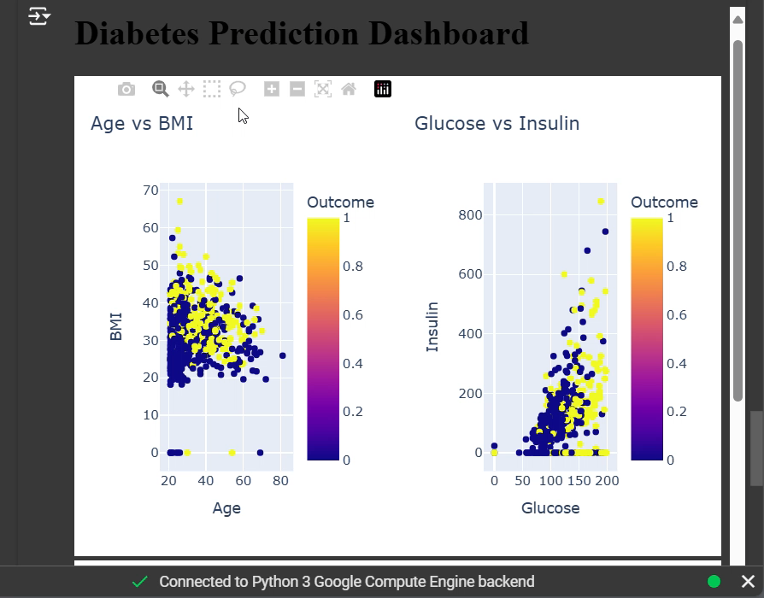
1. Scatter Plots
Age vs BMI: Displays the relationship between Age and BMI, color-coded by diabetes outcomes. Helps identify trends such as whether older individuals with higher BMI are more prone to diabetes.
Glucose vs Insulin: Highlights the correlation between Glucose and Insulin levels. Useful for identifying patterns in diabetic vs. non-diabetic individuals.
2. Outcome Distribution
Histogram: Shows the counts of patients with and without diabetes. Insights into dataset balance and prevalence of diabetes.
3. Feature Importance
Bar Chart: Ranks the importance of health metrics (e.g., Glucose, BMI, Age) in predicting diabetes. Explains the factors driving the model's predictions, improving trust and understanding.

Slide 17
End Users and Healthcare Benefits
End Users
Healthcare Professionals: Doctors, nurses, and specialists who use the dashboard to understand patient data and make informed decisions.
Medical Researchers: Analyze data trends to develop better preventive strategies for diabetes.
Patients: Input their data to learn about their potential diabetes risks.
Benefits in Healthcare
Preventive Care: Early identification of diabetes risk helps in timely intervention and lifestyle adjustments.
Personalized Insights: Understand which factors (e.g., Glucose, BMI) most influence individual diabetes risks.
Data-Driven Decision-Making: Visual insights assist in diagnosing and monitoring patient health effectively.
Scalability: Can be used in clinics, hospitals, and telemedicine platforms to assist diverse patient groups.

